Slide 1
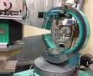
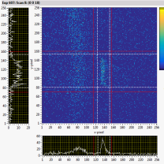
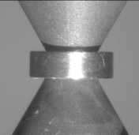
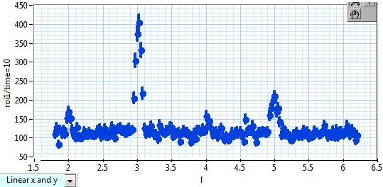
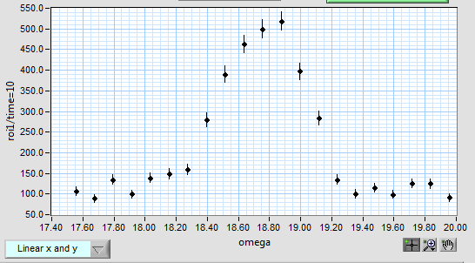
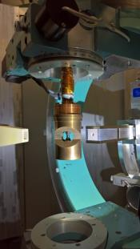
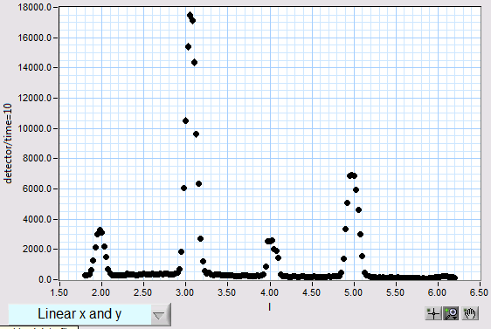
Initial test of the Diamond Anvil Cell (DAC) at HFIR HB-3A
Hexaferrite ~0.1 mm³ crystal with Pb medium in the DAC (no pressure loaded yet).
Sample unit cell: a = b = 5.82 Å, c = 43.28 Å. Wavelength 1.546 Å with filter. Counting time 10 s.
(0 0 18)
~0.1 mm³ crystal in DAC
DAC in beam seen by HB-3A crystal alignment camera
(0 0 18)
~10 mm³ crystal without DAC in a earlier measurement
Achievement
With an optimized region of interest, the background is ~ 10 cts/s
The data will be used to judge the feasibility of a future DAC experiment.
Pressure test in a Closed Cycle Refrigerator (CCR) upcoming on July 24th
Yan Wu, Huibo Cao, Jamie Molaison, Douglas Armitage, Katie Andrews, Bianca Haberl

